Slide 1

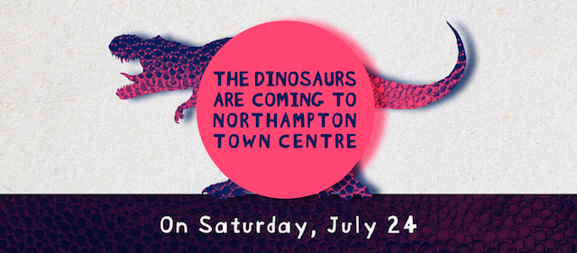
What do you know about dinosaurs?
Soon you’ll be a cleversaurus!

Slide 2
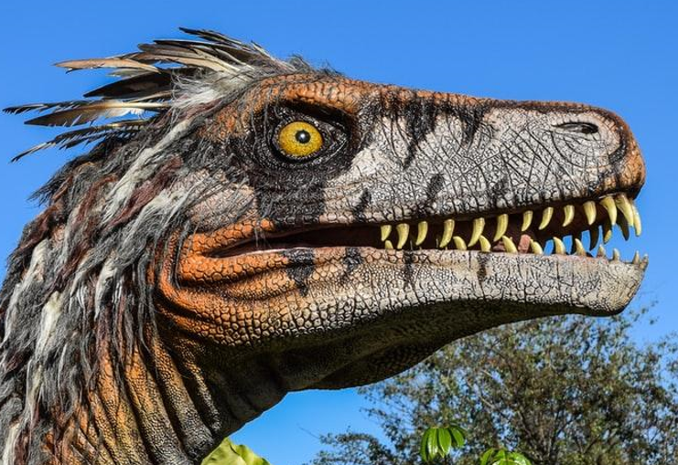
What are dinosaurs?
Dinosaurs are a group of prehistoric reptiles that lived during the Mesozoic era
(245 million to 68 million years ago)

Slide 3
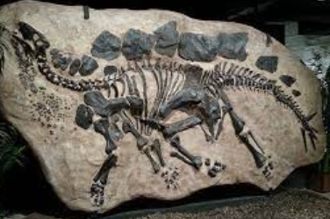
How do we know they existed?
What does a dinosaur fossil look like?
Fossils
Hundreds of years ago fossils were discovered that showed impressions (or print) of things like, their teeth, bones or footprints.

Slide 4
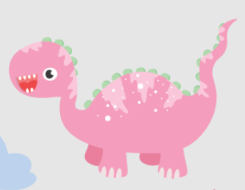
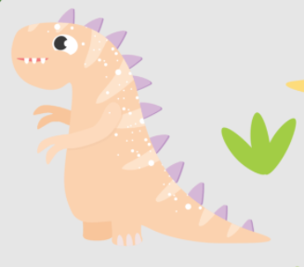
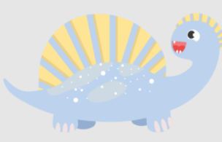
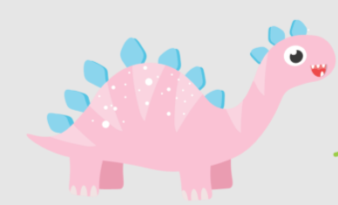
There were lots of different types of dinosaurs
Some moved speedily and some moved slowly.
Some walked on two legs, some had four.
Some dinosaurs had feathers. Some had thick, bumpy skin too!
Some had horns, frills or even spikes to defend themselves from predators.

Slide 5
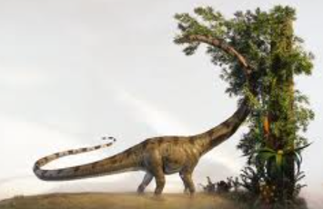
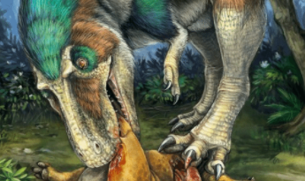
What did dinosaurs eat?
Herbivores
This means they eat plants .
Carnivores
This means they eat meat. .
Most dinosaurs ate plant-based food.
Some ate other animals.

Slide 6
Do you know anything about dinosaurs?
Talk to a partner!
Could they fly?
What did they look like?
How many legs did they have?
Did they run fast?
What did they eat?

Slide 7
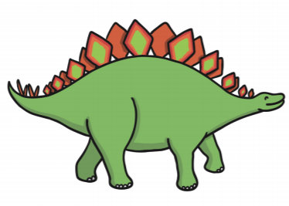
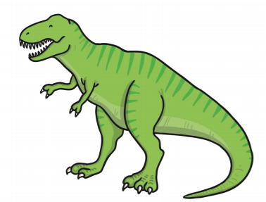
Here are four
Stegosaurus
They have upright plates on their back.
They are plant eaters (a herbivore).
They have a very small brain.
Tyrannosaurus Rex
They have two small arms.
They walk on two legs.
They eat meat (a carnivore).

Slide 8
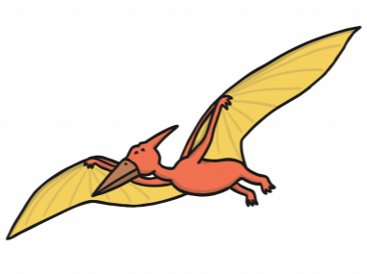
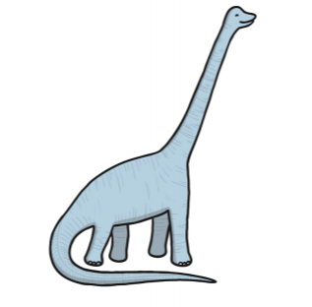
Pterodactyl
They use their wings to fly.
They eat meat (a carnivore).
They have a pointed beak.
Brachiosaurus
They have a very long neck.
They are the heaviest dinosaurs
They don’t eat meat (a herbivore).

Slide 9
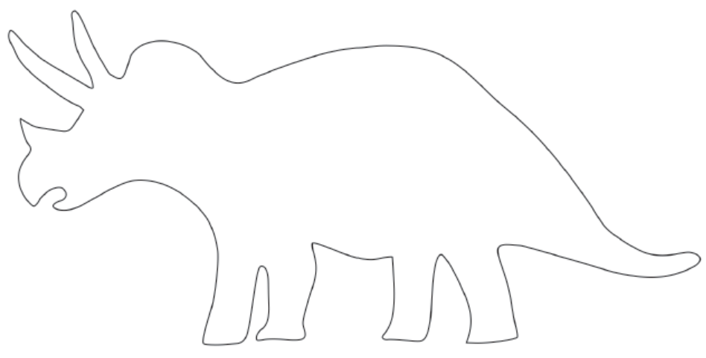
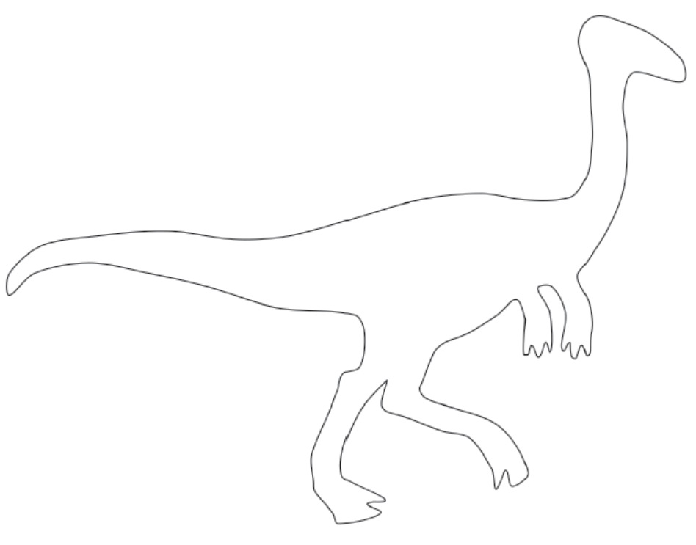
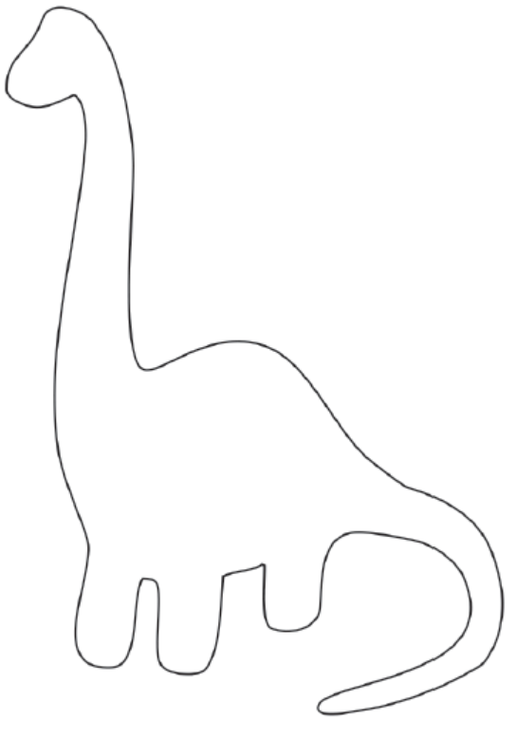
Can you design, make, colour or draw a dinosaur?
Get creative!
Send them to us. We would love to see them!
The best dinosaurs will be displayed across the town!
We’ve given you some
outlines to colour and decorate.

Slide 10
Start your summer holidays off with a STOMP!
Come face to face with triceratops!
Get up close to a T Rex!
Look out for special Dino diner meals.
The dinosaurs will entertain the town between 11 and 4pm.

Slide 11
Roarrr!
Join in the experience…
Don’t forget to come and see the dinosaurs come to life on 24th July in Northampton town centre.
This event is run by

